Slide 1
Team Members :
Soumili Nandi - sn3699
Kunal Thadani - kmt9501
Siddharth Shah - ss16130
Big Data, Section D, Spring 2024

Slide 2
Medicare Prescriber Fraud Detection Tool
00.00.00

Slide 3
Project statement
P A R T 0 1

Slide 4
P A R T 0 1
Brief Abstract
Healthcare fraud in USA, estimated to be between 3% to 10% of total healthcare spending, has a significant impact on Medicare's financial health.
Given the high costs associated with fraudulent claims—not only in monetary terms but also in terms of public trust—it is crucial to leverage advanced analytics to ensure the integrity of healthcare services.
There is a lack of publicly available datasets that can give us labeled dataset in medicare sector. Therefore, we create a labeled dataset ourselves.
The project utilizes public datasets such as the Part D Prescriber Dataset, Excluded Individuals and Entities (LEIE) dataset, and Payments Received to first collect as much information as possible to discover patterns in medical prescriber. Then we take the exclusion dataset to mark certain prescriptions as fraud or not. .

Slide 5
Objective
P A R T 0 2

Slide 6
P A R T 0 2
Objective
The most important objective of our project is merge all datasets to discover relationships and create a final l dataset that has labeled data as fraud/ not fraud.
Apply Big data tools to visualize the data in feature selection
Training and comparing multiple classifiers like Random Forest, Regression, Gradient Boosted Classification.
Visualize the result and show it to the user.

Slide 7
Data source/ Tech Stack
P A R T 0 2

Slide 8
P A R T 0 2
Data Sources
Tech Stack
Dataset 1 : Medicare Part D Prescriber Data
https://data.cms.gov/provider-summary-by-type-of-service/medicare-part-d-prescribers/medicare-part-d-prescribers-by-provider-and-drug
Dataset 2: Open Payments Data
https://download.cms.gov/openpayments/PGYR22_P011824.ZIP
Dataset 3: Office of Inspector - Exclusion list
https://oig.hhs.gov/exclusions/downloadables/UPDATED.csv
Google Colab
Python
PySpark
Dask
Pyspark - MLlib
Sklearn
Pandas
Matplotlib

Slide 9
Link to the codebase
P A R T 0 1
https://github.com/soumilinandi/Healthcare-Fraud-Detector-Tool
The readme provides all steps to reproduce the results using Google Colab :)

Slide 10
Results!
P A R T 0 2

Slide 11
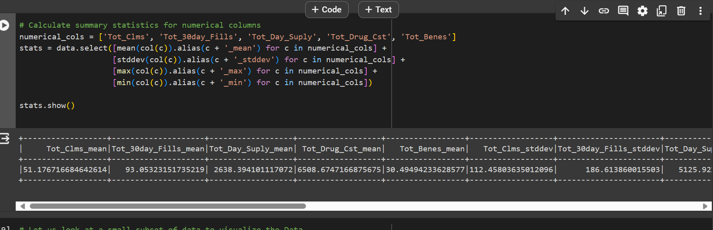
Data Engineering, Dataset 1
To understand data range of columns, we do :

Slide 12
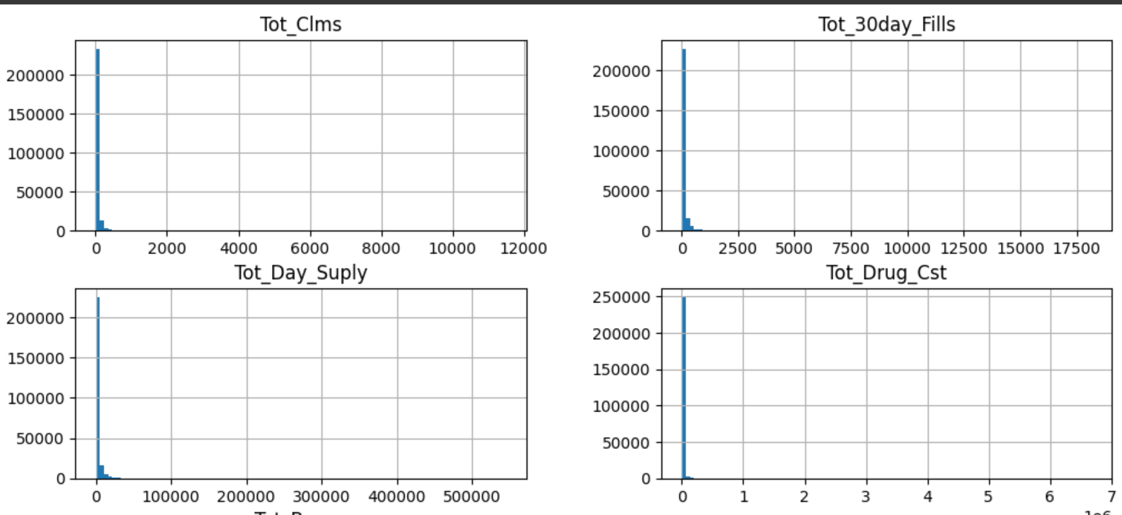
Data Engineering, Dataset 1

Slide 13
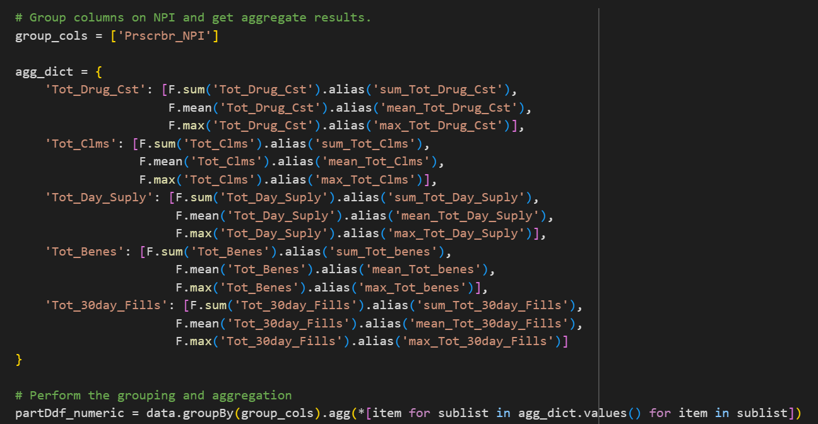
Data Engineering, Dataset 1
Adding extra information :

Slide 14
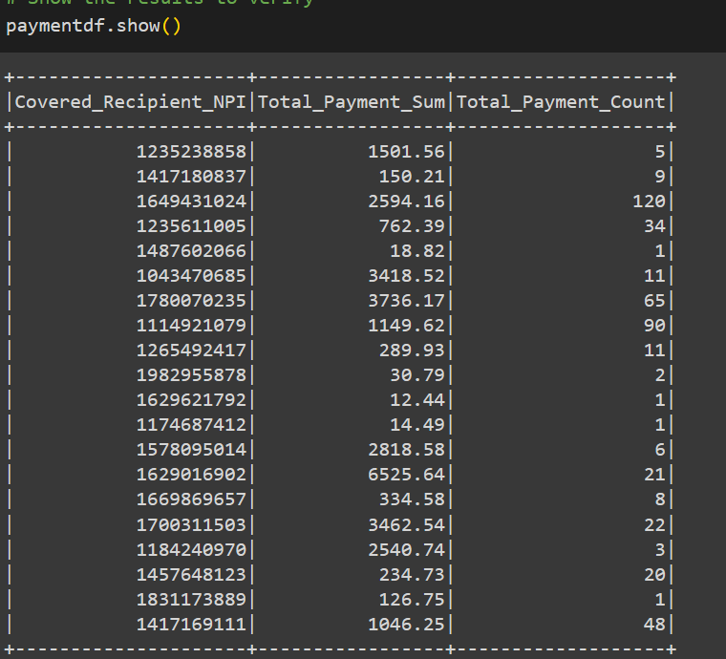
Data Engineering, Dataset 2
We extract 3 columns and group them based on NPI number as below

Slide 15
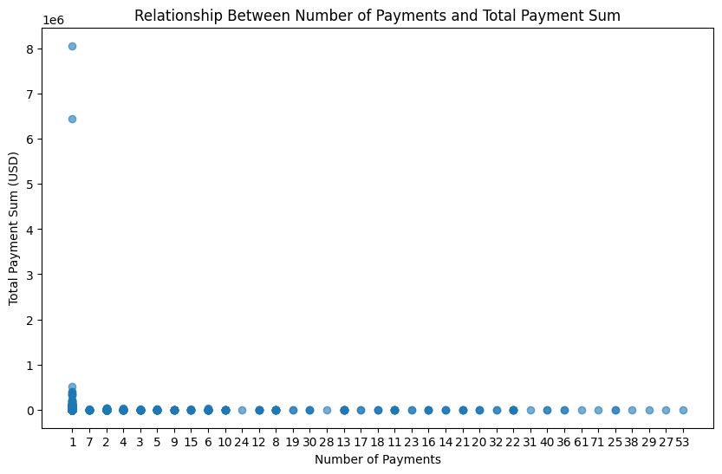
Data Engineering, Dataset 2

Slide 16
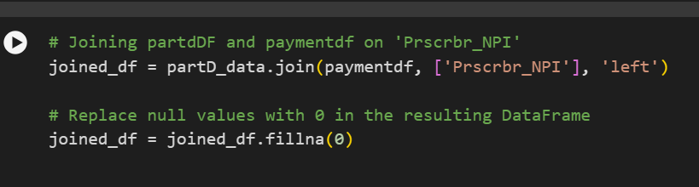
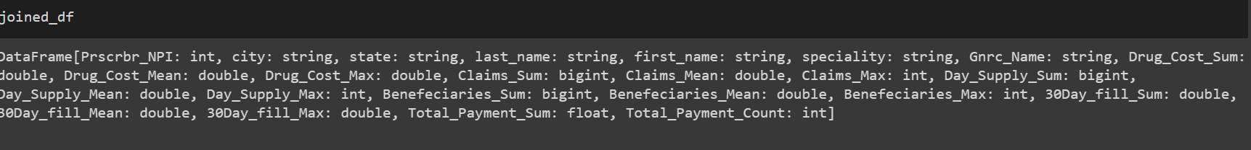
Data Engineering, Dataset 1+2
We join dataset 1 with dataset 2 based on NPI number

Slide 17
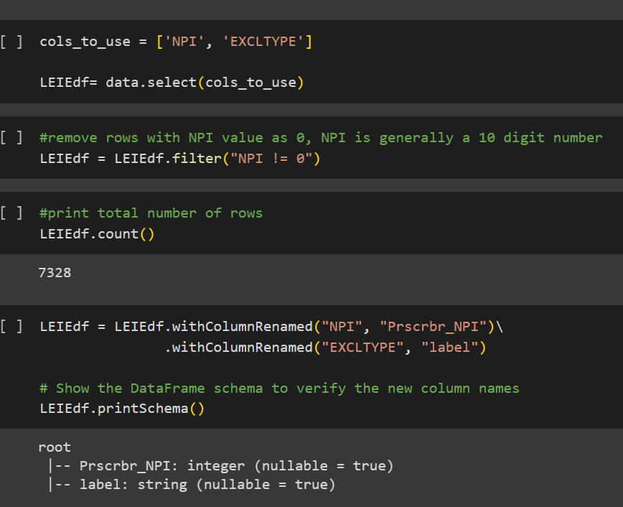
Data Engineering, Dataset 3

Slide 18
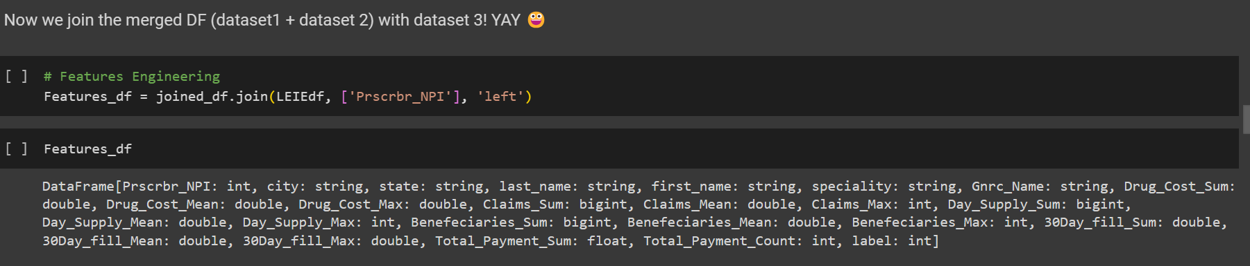
Data Engineering, Dataset 1+2+3
P A R T 0 1
Since its founding in 1831, NYU has been an innovator in higher education, reaching out to an emerging middle class, embracing an urban identity and professional focus, and promoting a global vision that informs its 19 schools.

Slide 19
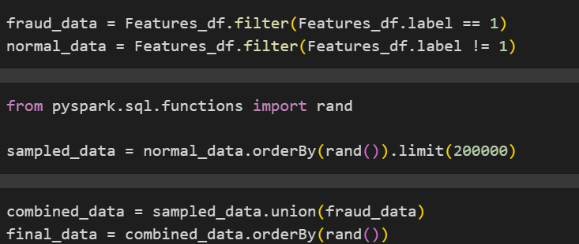
Data Engineering, Data Subset Selection
P A R T 0 1
To avoid a highly imbalanced dataset and recurrent issue of java heap space issue, we take the recommended size in proposal instructions

Slide 20
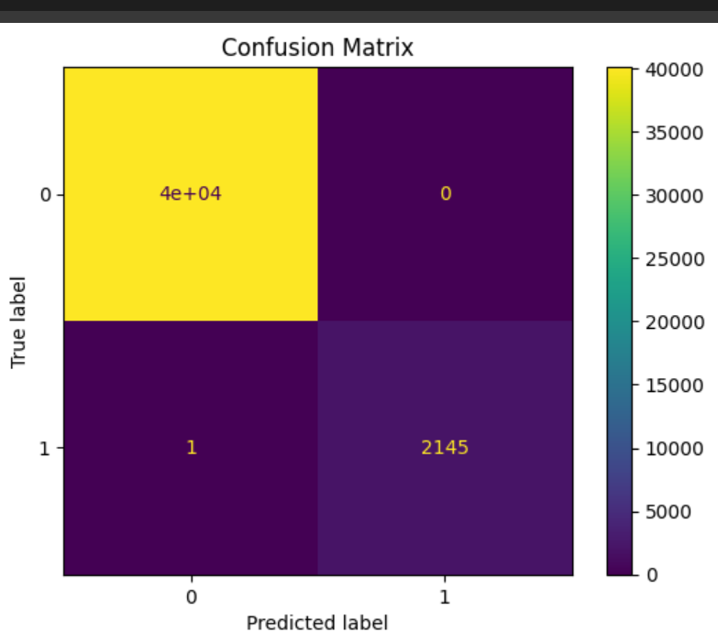
Model 1 : Random Forest
Accuracy
0.99997631

Slide 21
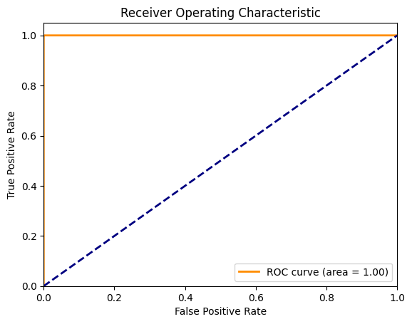
Model 1 : Random Forest

Slide 22
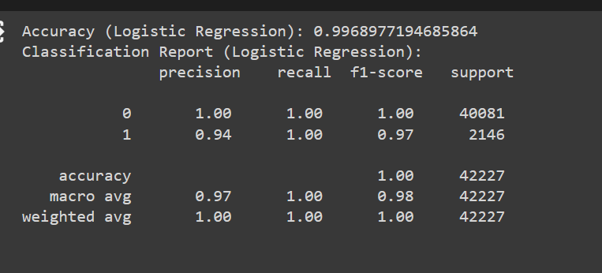
Model 2 : Linear Regression

Slide 23
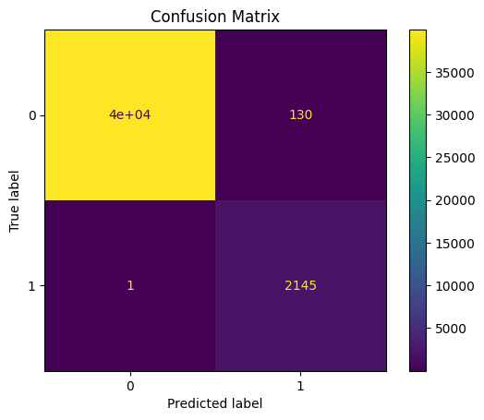
Model 2 : Linear Regression

Slide 24
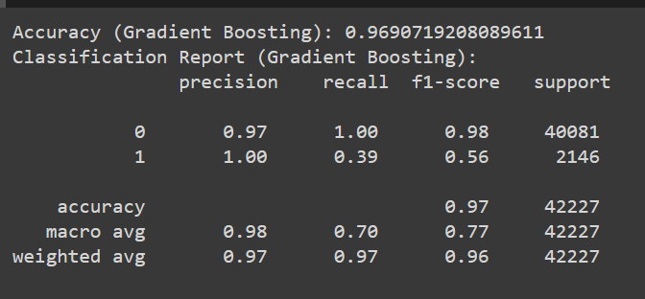
Model 3 : Gradient Boosting Classifier

Slide 25
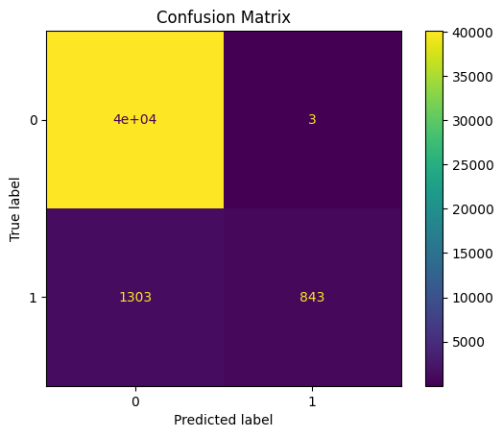
Model 3 : Gradient Boosting Classifier

Slide 26
Conclusion and lesson learned
Data Engineering to extract meaningful features is the most important part of this project. We tried running with lesser parameters but found out adding some more features like total beneficiary count, total payment count vs installation numbers, 30 days pattern were useful in improving the model.
It is essential to meaningfully replace or drop NaN values in such large database. We chose to drop the rows since we have a really large database.
It is crucial to understand different classes in databases and their ratio in real world scenario as well. Fraud prescribers are so rare, we try to represent this ratio in subset as well before applying ML Algos.

Slide 27
Conclusion and lesson learned
Pytorch is very useful in working with large databases. We tried to import the database using numpy but it gave us errors, PySpark came to our rescue! We chose it over Dask because of its resources.
When dealing with large numbers in databases, it is beneficial to scale data. We did log scaling.
After taking subset of data, we found out that it was faster to convert it to Pandas dataframe and use sklearn for the algorithms then to continue with Pyspark and MLlib.
Visualization helped in understanding features and even comparing the results.

Slide 28
Conclusion and lesson learned
Random Forest gave us the best precision on test data. It was able to correctly recognise both the classes overall. It achieved almost a perfect score in both the classes!
Linear Regression also performed well. It does very well in classifying fraud data but records 130 normal records as anomalous.
Gradient boosted Classifier does not do that well. It makes a few mistakes in both classes. It wrongly classified 1303 fraud data as normal which is significant considering that we only have about 2100 fraud data in test set.
We conclude that for our use case, Random Forest in the best model which has learnt really well to understand patterns in out data to classify fraud.

Slide 29

Thank you
We had a great time solving all challenges and projects in the course!

